Slide 1
WELCOME
to
Closing Meeting
OFI Points

Slide 2
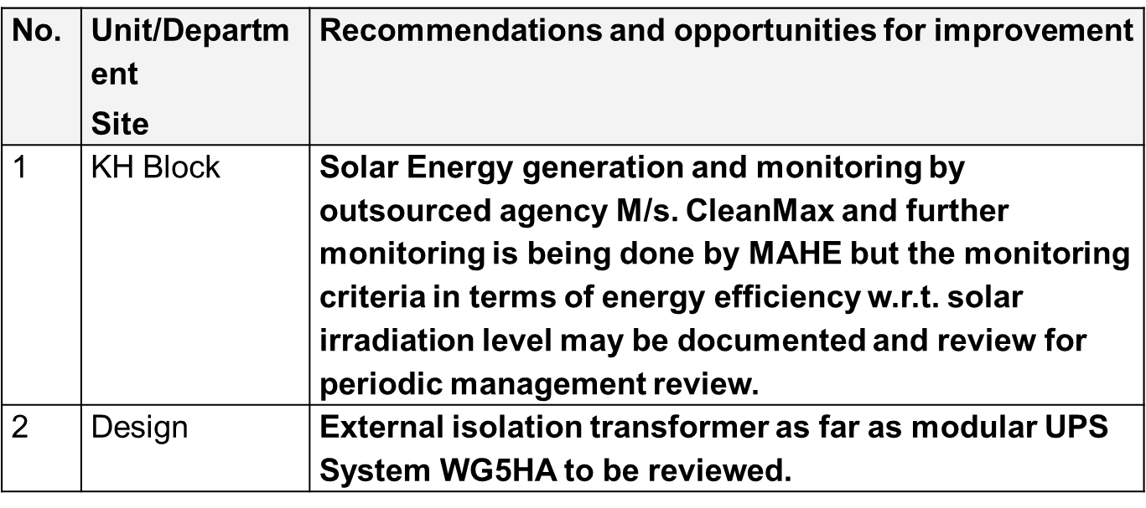
Opportunities for improvement – ISO 50001:2018

Slide 3
Opportunity for Improvements ISO 9k & 14k
All the Procedures and Records can have Reference Numbers. Rev. date etc.
Risk and Opportunities identified at all sites can be Reviewed as the same are reviewed during 2020.
Objectives of QMS & EMS set at all sites can be specific with targets Awareness to all the Internal Auditors need improvement as in few case they recorded as ISO 9001: 2008…
Roles, Responsibilities & Authorities can be documented college/site-wise in Manual or respective institute documents.
Display Boards of Emergency Exit can have Arrow towards Safe Assembly Point in few areas
Aspect Impact Procedure can be reviewed w.r.t identifying the significant score.(SOD)

Slide 4
Opportunity for Improvements
Ambulance KMC Manipal: Basic licence Support is invalid for Mr Sandesh kumar-Ambulance Driver(Valid till: April 2022.
Deputy Register Academics:
Review of guideline : Regulations Covering Board of Studies as the same is prepared on 10/8/2010.
Process for closure of courses can be established covering use of resources, infrastructure, including regulatory requirements if any.
Artificial Limb Centre:
Process of getting patient feedbacks can be established for the dept.
Aspect & Impact Analysis need to be strengthened as “generation of used oil, POP..etc are not considered.

Slide 5
Opportunity for Improvements
Registrar – Evaluation
The present result declaration time is based the completion of evaluation instead can think of changing target time from the date of last date of examination.
NEP Guidelines can be reviewed and applicable sections can be identified and action plan can be prepared for the applicable clauses as there is no plan presently.
No examination committee meetings for the year 2020 & 2021 – would have conducted remotely through teams
No discussion/agenda on the “data security” during examination committee meetings as the data (Exam details/Answers) handled by external vendor.

Slide 6
Opportunity for Improvements
Data security/confidentiality clause is missing in the contract and no requirement of Vulnerability screening and Penetration testing as the vendor maintain the examination data.
Majority of the terms & condition in the contract are in favour of vendor as the same is initiated by vendor.
Procedure for Handling grievances can be established . The Grievances related to examination process like tab not working, not able to save…are not recorded as grievances and corrective actions are initiated.
There is no identification of cause and corrective actions for the grievances identified and recorded as the action is only correction.
Criteria for selection of “Surprise Visit Squad” is not defined and there are no records of visits including the observations and action on the same.

Slide 7
Opportunity for Improvements
The present control on decentralised institutes is only Internal Audit but there is no corrective action plan for the Internal Audit findings.
There is no offsite back up on the data of Evolution/Examination server.
Guidelines for the employees of “Question Bank” can be established included what is allowed and what is not allowed (Mobile entry is not allowed, taking print out data.
Manipal School of Information Science:
The criteria for selecting the members for the PAC, IAC members can be established
School of Dental Science : Mangalore
Infection committee meeting to be strengthened covering to review the data of the period, Immunisation status….

Slide 8
Opportunity for Improvements
School of Dental Science : Manipal
Suggestion box at front office has not opened since Sept 2021 as few suggestions were in the box- Process on opening the suggestion box and taking action on the suggestions received can be defined and followed.
Shelf life details can be maintained in the software at Stores to ensure the same are disposed after the expiry date. Manipal School of Information System
Calibration status records can be maintained on the pressure gauges of the Fire Hydrant System.
Environmental Monitoring Reports of Water, Stack Emissions of DG set and other parameters can be kept at respective Sites / College. Manipal School of Architecture and Planning
Evacuation plan/Layouts Prints can be displayed in prime locations of the building. Indicating fire extinguisher, Alarm.

Slide 9
Opportunity for Improvements
MANIPAL CENTRE FOR NATURAL SCIENCE
Precautions should be displayed for pregnant lady near radio active sources.
License to be available for radioactive sources.
TLD batches should be used for radioactive sources
MANIPAL COLLEGE OF DENTAL SCIENCES, MANGALORE
Porthodontics Lab (Dental Materials):Calibration Record for Pressure
Gauge for LPG line (Rating 0 to 6 Kg/Cm2) was not evidenced.
Chemical Spillage was observed in the lab area, recommended to use secondary containment
Aspect Impact for the Water Heaters, LPG Usage, etc. can be captured
Expired chemical return policy may be maintained

Slide 10
Minor Non- Conformances ISO 50001:2018
1 NC Statement: The process of operational control and planning of SEU processes is not effective.
Requirement: The organization shall plan, implement and control the processes, related to its SEUs…. implement the actions determined in 6.2, by communicating (see 7.4) the criteria to relevant person(s) doing work under the control of the organization;
Objective evidence: →Ref: Energy Planning Sheet Year 2022-23 of Kasturba Medical College and Health Science – International Hostel
The monitoring of energy performance of SEU area of Energy Consumption per Sq M (Kwh/Sq. M) in HVAC area and Energy Consumption per Litre of Diesel consumption (Kwh/Ltr) in DG Set Area with operating team was not available.

Slide 11
Audit Conclusion
Recommended for Re Certification
Congratulations!!!

Slide 12
Right to Appeal

Slide 13
THANKS FOR YOUR SUPPORT

